Slide 1
Marianna Esposito Vinzi

Slide 3
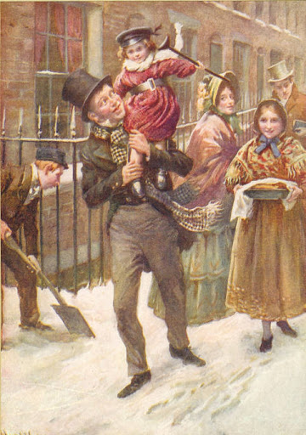
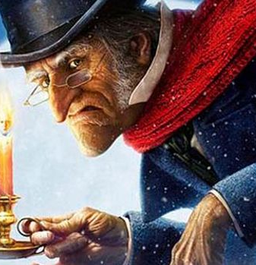
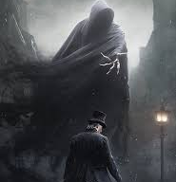
A Christmas Carol

Slide 4
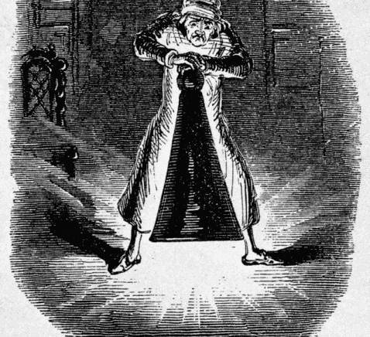
Scrooge is visited by a ghostly specter which is his deceased business partner, Jacob Marley. He is wrapped in chains entwined with moneyboxes and he tells Scrooge that he is doomed to roam earth in the heavy chains as punishment for his greed.

Slide 5
Happiness, kindness, benevolence and cordial embrace are welcome and all the children look forward to Christmas in a fever of anticipation. This brilliant book is universal in terms of its themes for any age. Scrooge, finally displays kindness and generosity to everyone he meets and he definitely embodies the true spirit of Christmas, which is love, sharing, warmth and friendship.

Slide 6
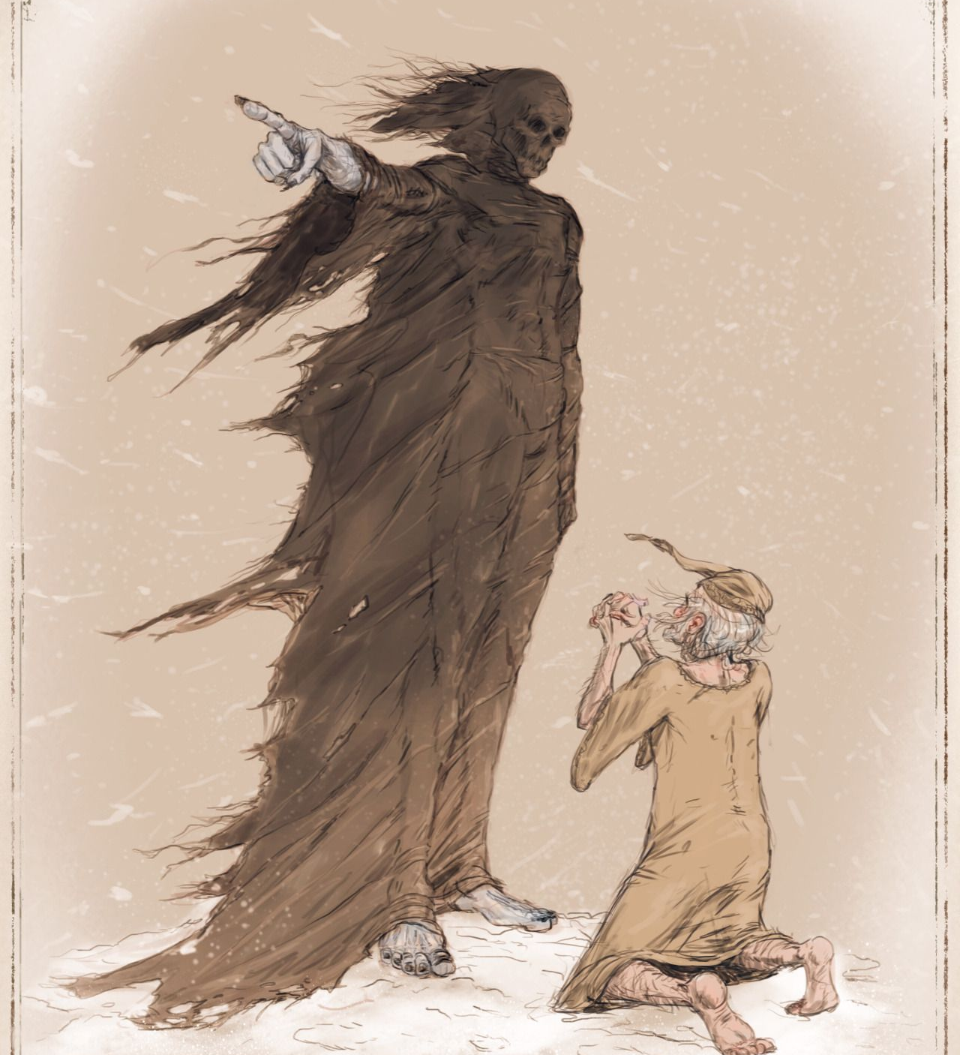
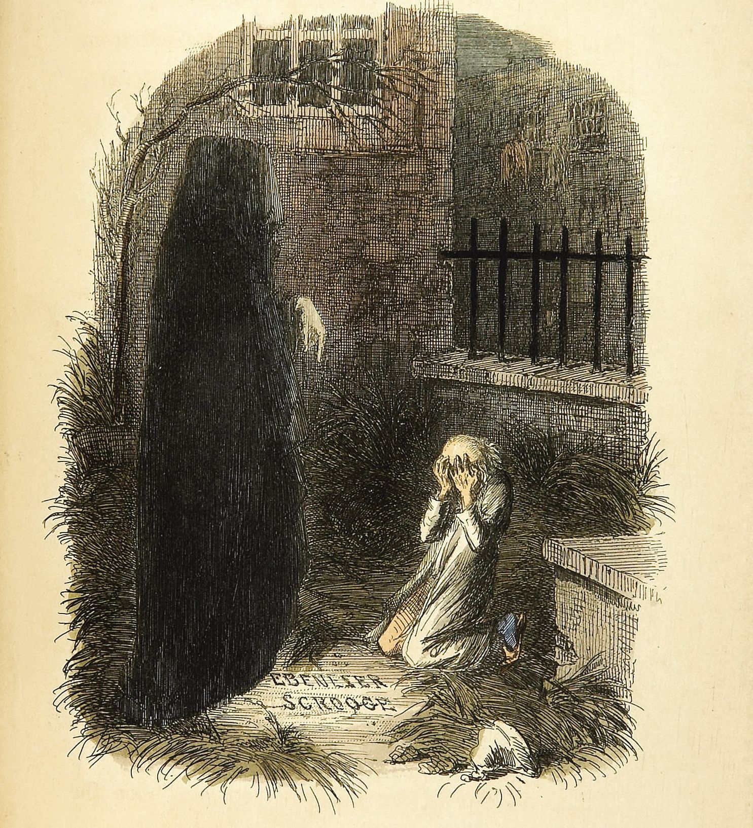
Scrooge’s horror grows when he discovers his name on the headstone of a grave overrun by grass, a neglected grave. Scrooge begs the spirit to return him to his life in order to change his ways and avoid a terrible, bleak, dark future

Slide 7
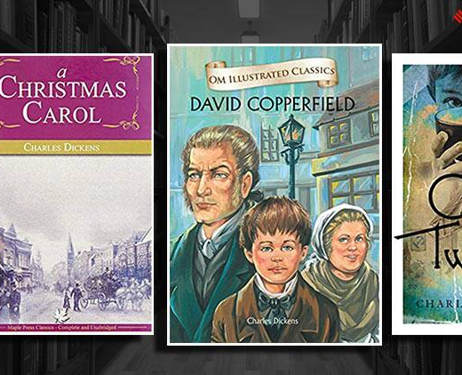
Charles Dickens 1812-1870

